Slide 1
Analysis of Air Quality and Recommendations for Improvement
Insights, Trends, and Actionable Solutions
-- Harsh Jha

Slide 2
Introduction and Objective
Objective:
Analyze air quality data, identify key pollutants, and propose actionable solutions.
Key Findings:
Identified key pollutants contributing to poor AQI: PM2.5, PM10, NOx, CO.
Recognized seasonal variations, with November having the worst air quality.
Cities with the highest AQI: Delhi, Ahmedabad, UK, Patna, Gurugram.

Slide 3
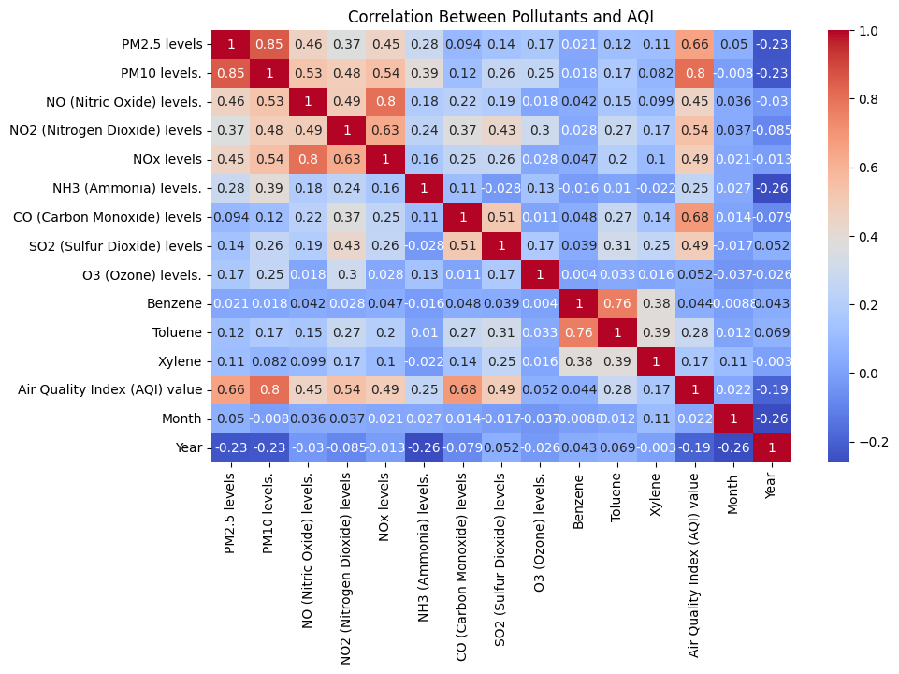
Key Pollutants Impacting Air Quality
Key Pollutants:
PM10, PM2.5: Strong correlation with AQI.
NOx: Nitrogen Oxides significantly contribute to air quality deterioration.
CO: Carbon Monoxide from vehicle emissions and industries.
Recommendations:
Stricter industrial and vehicular emission controls.
Promotion of cleaner energy (e.g., solar, wind).
Public awareness campaigns on the risks of PM2.5 and NOx.

Slide 4
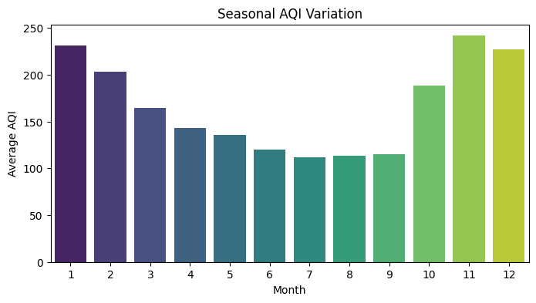
Seasonal Variations in Air Quality
Findings:
November has the worst AQI due to crop burning and other seasonal factors.
Recommendations:
Health Advisories: Issue during high-pollution months (e.g., November).
Regulations on Crop Burning: Promote alternatives like biomass conversion technologies.

Slide 5
Cities with the Worst AQI
Top Cities:
Delhi, Ahmedabad, UK, Patna, Gurugram.
These cities consistently have high AQI, indicating severe air quality issues.
Recommendations:
Public Transportation: Enhance metro and bus networks to reduce vehicular emissions.
Increase Green Spaces: Plant more trees and create urban forests to absorb pollutants.
Install AQI Monitoring Systems: Provide real-time updates to residents.
Create Low-Emission Zones: Restrict high-emission vehicles in critical areas.

Slide 6
Methodology
Data Cleaning:
Handled missing values using pd.to_numeric() and dropped rows with missing AQI values.
Analysis:
Correlation Analysis: Identified key pollutants correlated with AQI.
Seasonal Variations: Analyzed AQI by month to identify trends (November had the worst AQI).
City-level Analysis: Focused on cities with the highest AQI (Delhi, Ahmedabad, etc.).

Slide 7
Actionable Solutions for Air Quality Improvement
Air Quality Forecasting Tools:
Implement machine learning models to predict future AQI trends and prepare residents for high-pollution days.
Real-time AQI Monitoring:
Install AQI monitoring systems across cities to give residents real-time updates.
Public Awareness and Policy Advocacy:
Launch awareness campaigns about the health impacts of poor air quality and promote clean energy practices.
Advocate for stricter emission regulations and seasonal bans on crop burning.

Slide 8
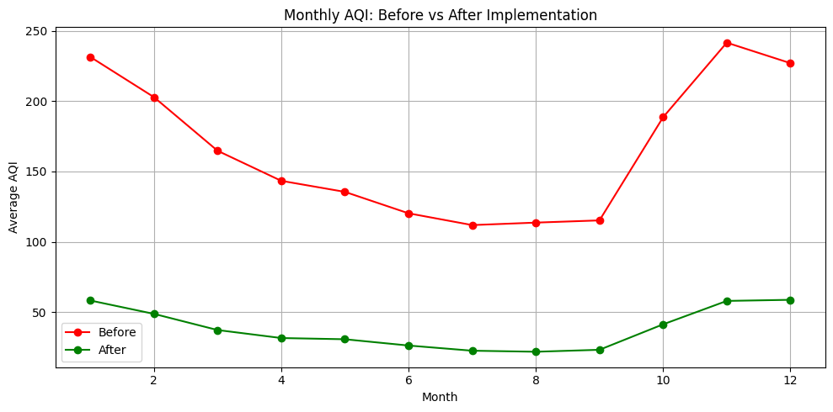
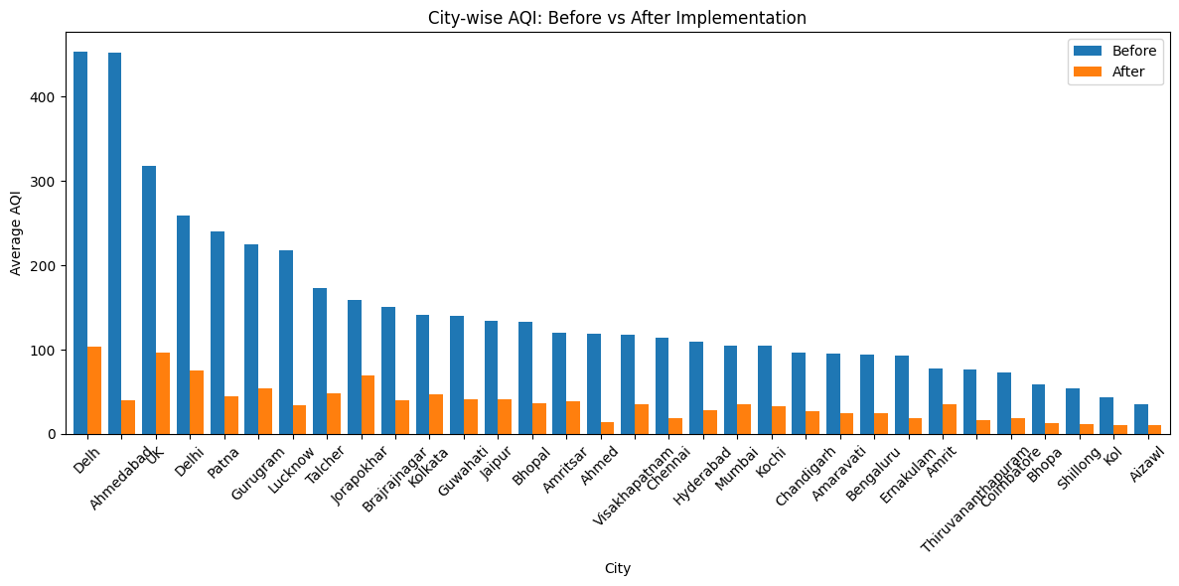
Conclusion
Summary:
This analysis has provided insights into the major contributors to poor air quality and proposed targeted solutions to improve AQI across cities.
Impact:
Implementing these solutions will:
Reduce pollution.
Improve public health.
Create sustainable, cleaner air for future generations.

